Slide 1


CampusPharma
Company targets 2024

Slide 2
Campus – company governance over time
Campus cornerstones -> review in connection with 5-year plan
HERITAGE
VISION
BUSINESS IDEA
FOCUS
CORE VALUES
STRATEGC DIRECTION
STRATEGIC TARGETS
Del av
5-årsplan –> review Q4 every year
COMPANY TARGETS
TEAM TARGETS
PERSONAL TARGETS
Annual goals –> to be set in January

Slide 3
Strategc direction and targets
Strategic direction
Long term growth → current products & new products
Sustainable profitability → ”right gross margin” & ”costs”
Increased interaction → within Campus, with ITF and customers
Compliance legal requirements → Laws, regulations & rules
Long-term sustainable development → UN global goals
Strategic targets
5 year plan 2021-25
Growth → launch at least 2 new products per year
Profitabilityt → reach a gross margin of at least 50% in 2025
Interaction → working methods/processes that increase interaction...
Compliance → GMP/GDP, labor law, marketing etc...
Sustainability → operational management / sustainability goals / sustainability reporting...

Slide 4
Company targets - Team targets - Personal objectives
Company targets
Profitability
Gross margin
Marketing margin
EBIT
Etc…
Growth
Budget
Gross sales etc
New launches
Team targets & personal objectives
for example
Sales
Profitability
Interaction
Compliance
Sustainability
Interaction
Compliance
GMP/GDP…
Way of working…
Marketing…
Etc…
Sustainability
Sustanability report
Etc…

Slide 5
Company targets 2024 - figures
Company targets 2024
Growth target Target 2024 Outcome 2023 Outcome 2022
Gross sales → 233,3 MSEK = +13,2% 2023 = 206,0 MSEK → +16,0% 2022 = 177,6 MSEK → +2,3%
New launches → 1 (Natalben Prec-conception)
Profitability targets
Gross margin → 114,1 MSEK = 48,9% 2023 = 90,8 MSEK = 44,0% 2022 = 77,6 MSEK = 43,6%
Distr. & Logistics → 12,1 MSEK = 5,1% 2023 = 10,25 MSEK = 5,0% 2022 = 9,2 MSEK = 5,2%
Penalties tenders → 0,2 MSEK = 0,01% 2023 = 0,0 MSEK = 0,0% 2022 = 0,2 MSEK = 0,1%
Destruction & Returns → 2,6 MSEK = 1,1% 2023 = 4,9 MSEK = 2,4% 2022 = 1,1 MSEK = 0,6%
Marketing margin → 66,0 MSEK = 28,3% 2023 = 47,0 MSEK = 22,8% 2022 = 42,7 MSEK = 24,0%
G&A expenses → 15,2 MSEK = 6,5% 2023 = 14,7 MSEK = 7,1% 2022 = 13,3 MSEK = 7,4%
R&D expenses → 13,6 MSEK = 5,8% 2023 = 11,6 MSEK = 5,6% 2022 = 12,0 MSEK = 6,8%
EBIT → 36,0 MSEK = 15,4% 2023 = 19,9 MSEK = 9,7% 2022 = 17,4 MSEK = 9,8%
Compliance & Sustainability targets
Se individual document "Sustainability strategy" and "Quality system" respectively

Slide 6
Company target 2024
IMPROVE
CASH FLOW
MARKETING SALES LOGISTICS FINANCE G&A RA QA PV
SALES
Increase sales
2) Focus on high margin products
3) Right allocation of human& financial resources…
PRODUCTS
Check product profitability
2) Remove unprofitable products
COSTS LOGISTICS
Distribution
Freight
Warehousing
Stock handling
2) Inventory
Stock level
Destruction
Returns
COSTS
OTHER
Marketing
Sales
Promotion
Finance
G&A
RA
PV
QA
BUSINESS DEVELOPMENT
Launch 2 new products per year
Pipe line new products
Product development & line extentions…
Sales -> higher sales = better cash flow
Product margins -> higher product margins = better cash flow
Costs -> lower costs = better cash flow

Slide 7
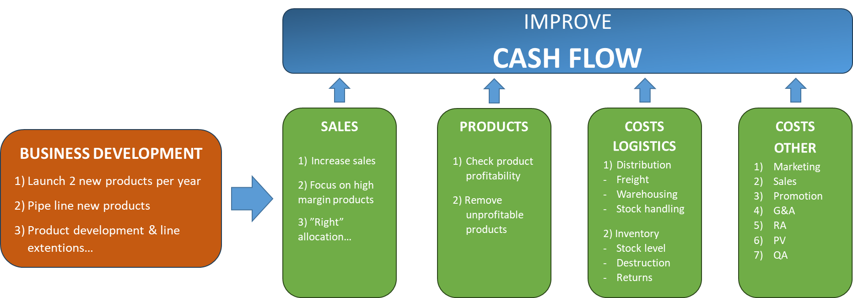
Company target 2024 -> Team targets
OBS!
Exempel
SALES PRODUCTS COSTS
1) Reach Bgt -> Exceed Bgt 1) Product profitability 1) Staff, General exp., 2) Focus on high margin products Promotion etc
2) ”Right” allocation 3) Review of present costs… 4) Cost control & optimation
MARKETING & SALES
COSTS
Review of present costs… -> freight, warehousing, stockhandling, distribution etc
Cost control & optimation…
Inventory -> optimal stock level over time, minimal returns & destruction etc
SUPPLY & LOGISTICS

